Slide 1
CHAPTER 6
Arithmetic and Logic Operations

Slide 2
WHAT WILL WE LEARN?
Which arithmetic and logic operations can be applied to digital images?
How are they performed in MATLAB?
What are they used for?

Slide 3
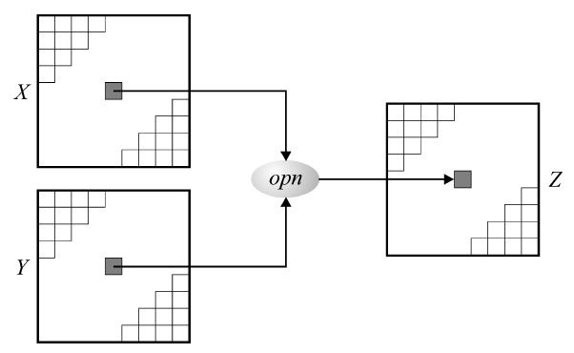
Arithmetic and logic operations
Combine two images, pixel-by-pixel, using an arithmetic or logical operator, resulting in a third image, Z:
X opn Y = Z

Slide 4
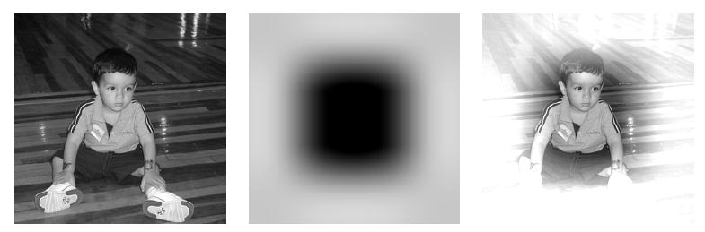
Addition
Used to blend the pixel contents from two images or to add a constant value to an image's pixel values.
Example 1 (blending two images): Z = X+Y

Slide 5
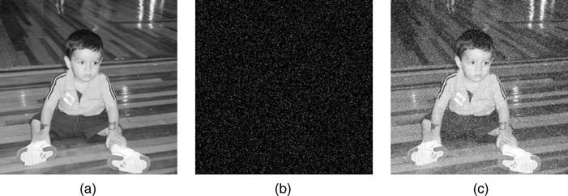
Addition
Example 3 (additive noise):
Z = X + N

Slide 6
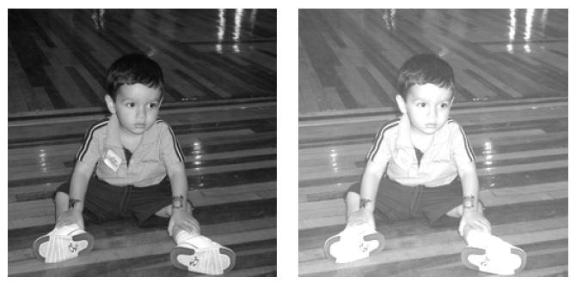
Addition
Example 2 (additive image offset):
Z = X + 75

Slide 7
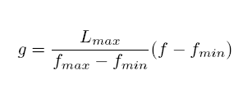
Addition in MATLAB
imadd function (see Tutorial 6.1)
Handling overflow:
Truncation
Normalization

Slide 8
Addition in MATLAB
Handling overflow (Example 6.1):
X = uint8([200 100 100; 0 10 50; 50 250 120])
Y = uint8([100 220 230; 45 95 120; 205 100 0])
W = uint16(X) + uint16(Y)
fmax = max(W(:))
fmin = min(W(:))
Za = uint8(255.0*double((W-fmin))/double((fmax-fmin)))
Zb = imadd(X,Y)

Slide 9
im = imread('pout.tif');
imshow(im)
im = double(im);
im = im/max(im(:))*255;
sigma=10;
n = randn(size(im)) * sigma;
imnoise = im + n;
figure; imshow(imnoise/255)

Slide 10
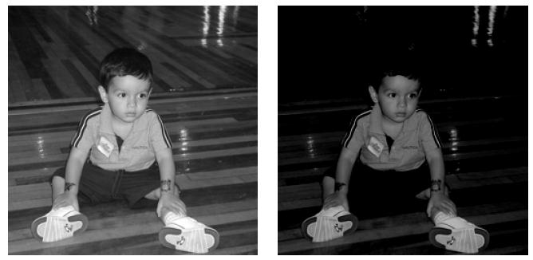
Subtraction
Used to used to detect differences between two images, decrease its overall brightness, or obtain its negative.
Example 1 (subtractive image offset): Z=X-75

Slide 11
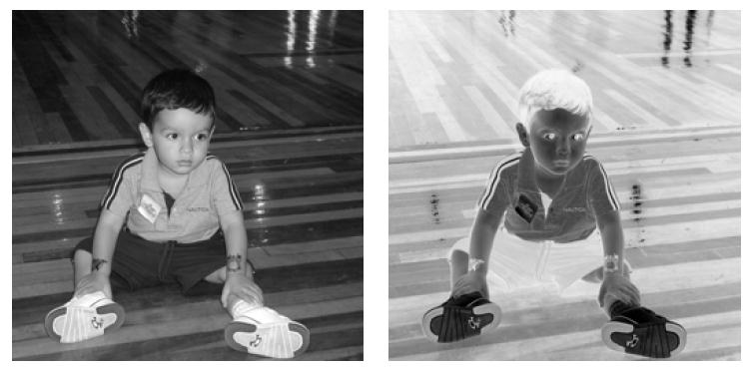
Subtraction
Example 2 : negative of an image

Slide 12
Subtraction in MATLAB
Three functions:
imsubtract
imabsdiff
imcomplement
Example 6.2:
X = uint8([200 100 100; 0 10 50; 50 250 120])
Y = uint8([100 220 230; 45 95 120; 205 100 0])
Za = imsubtract(X,Y)
Zb = imsubtract(Y,X)
Zc = imabsdiff(Y,X)

Slide 13
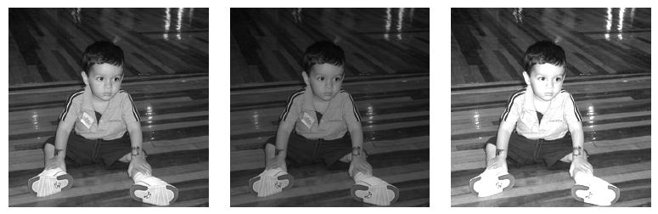
Multiplication and division in MATLAB
Functions:
immultiply
imdivide
Example (Fig. 6.6):

Slide 14
Logic operations
Performed in a bit-wise fashion on the binary contents of each pixel value.
AND, XOR and OR require two or more arguments.
NOT operator only requires only one argument.
Book examples use the convention: 1 (true) for white pixels; 0 (false) for black pixels.

Slide 15
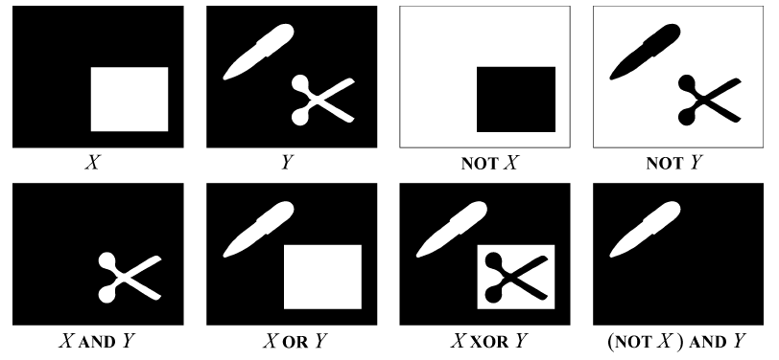
Logic operations
Examples using binary test images

Slide 16
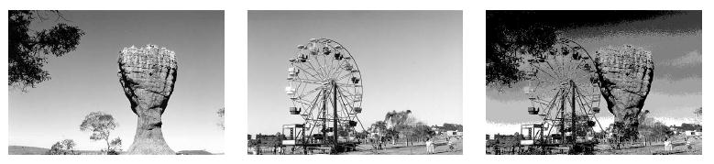
Logic operations on monochrome images
Example 1 (AND)

Slide 17
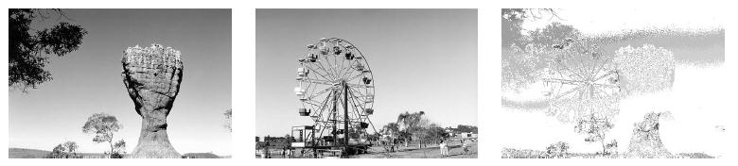
Logic operations on monochrome images
Example 2 (OR)

Slide 18
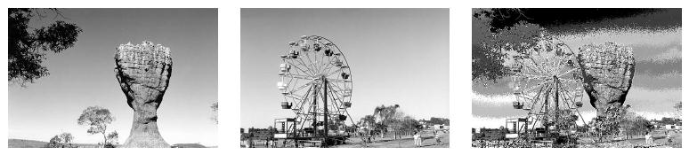
Logic operations on monochrome images
Example 3 (XOR)

Slide 19
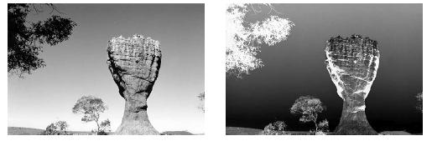
Logic operations on monochrome images
Example 4 (NOT)

Slide 20
Logic operations in MATLAB
Functions (see Tutorial 6.2):
bitand
bitor
bitxor
bitcmp

Slide 21
Hands-on 
Tutorial 6.1: Arithmetic operations (page 113)
Tutorial 6.2: Logic operations and region of interest (ROI) processing (page 118)

